Slide 1
Agent Architectures
NJU
March, 2023

Slide 2
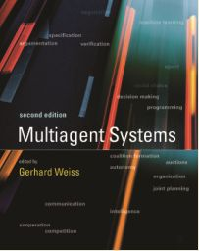

Agent
MULTIAGENT SYSTEMS
edited by Gerhard Weiss
MIT Press, 2013, 2nd edition
Multiagent Systems Algorithmic, Game-Theoretic, and Logical Foundations
Yoav Shoham Kevin Leyton-Brown Cambridge University Press, 2009

Slide 3


What is an intelligent agent?
Fields that motivate agent technologies
Artificial intelligence
AI is the intelligence by machines or software
Major AI researchers and textbooks define this field as "the study and design of intelligent agents"
[wikipedia: artificial intelligence]
Artificial Intelligence: Foundations of Computational Agents [link], Cambridge University Press, 2010
"AI is the field that studies the synthesis and analysis of computational agents that act intelligently. "
Topics in the book: reasoning, learning, planning, etc.
Agent is the carrier of artificial intelligence.

Slide 4
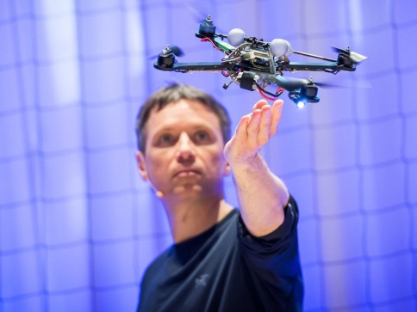
What is an intelligent agent?
Fields that motivate agent technologies
Software engineering
SE is the study and an application of engineering to the design, development, and maintenance of software.
[wikipedia: software engineering]
M. Wooldridge
[Wooldridge 1998]
Complexities come from: environment, interaction, system specification, …
What is a good software / system?
*
System
functional,
reactive,
...
input
output
Environment
OS, physical world, ...
[Wooldridge 1998] M. Wooldridge, Agent and software engineering, in: AIIA, 1998.
* Image from http://www.ted.com/talks/raffaello_d_andrea_the_astounding_athletic_power_of_quadcopters, Aug 4, 2015.

Slide 5

What is an intelligent agent?
Fields that motivate agent technologies
Distributed system
A software system in which components located on networked computers communicate and coordinate their actions by passing messages
[wikipedia: distributed computing]
天基红外系统
军事战略战术中继卫星
联合监测目标攻击雷达系统
战区防空与导弹防御
战区高空防御导弹

Slide 6
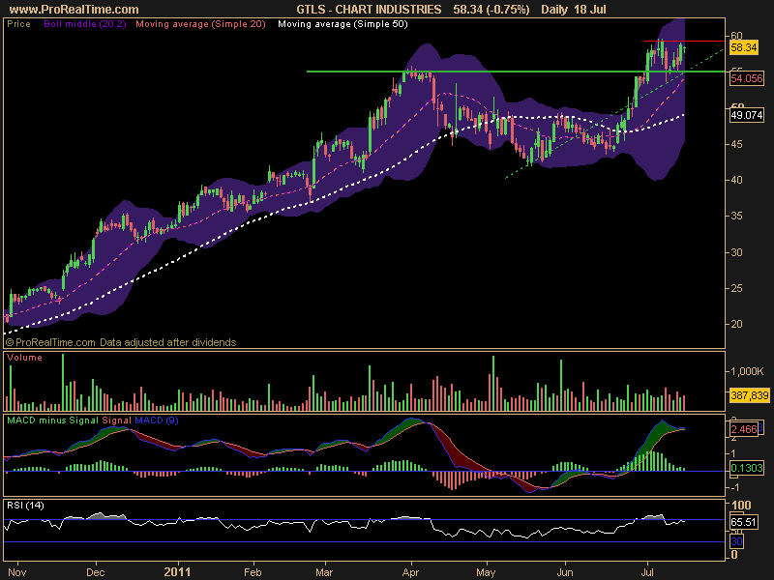
What is an intelligent agent?
Fields that motivate agent technologies
Economics
In economics, an agent is an actor and more specifically a decision maker in a model of some aspect of the economy.
[wikipedia: agent (economics)]
[wikipedia: program trading]
[wikipedia: algorithmic trading]
[wikipedia: high-frequency trading]

Slide 7
Defining Agency
• What are the characteristics of an agent?
• This is a question that gets a lot of discussion! (Compare object.)
• For our purposes, we find it useful to introduce two increasingly strong notions of agency:
– weak agency; (primarily the software agents community)
– strong agency; (primarily AI).

Slide 8
A Weak Notion of Agency
An agent is a hardware or (more usually) software-based computer system that enjoys the following properties:
Autonomy: agents operate without the direct intervention of humans or others, and have some kind of control over their actions and internal state;
Reactivity: agents perceive their environment, and respond in a timely fashion to changes that occur in it;
[Wooldridge&Jennings 1995] M. Wooldridge & N. R. Jennings, Intelligent agents: theory and practice, Knowledge Engineering Review, 10: 115-152, 1995.

Slide 9
A Weak Notion of Agency
… the term agent is used to denote a hardware or (more usually) software-based computer system that enjoys the following properties:
Proactiveness: agents do not simply act in response to their environment; they are able to exhibit goal-directed behavior by taking the initiative;
Social ability: agents interact with other agents (and possibly humans) via some kind of agent-communication language.
[Wooldridge&Jennings 1995] M. Wooldridge & N. R. Jennings, Intelligent agents: theory and practice, Knowledge Engineering Review, 10: 115-152, 1995.

Slide 10
A Strong Notion of Agency
For some researchers — particularly those in AI — the term ‘agent’ has a stronger meaning.
These researchers generally mean an agent to be a computer system that, in addition to having the properties identified above, is either conceptualised or implemented using concepts usually applied to people:
mentalistic notions (belief, desire, obligation, choice
rationality
veracity
adaptability/learning.

Slide 11
Agent Architectures
We want to build agents, that enjoy the properties of autonomy, reactiveness, pro-activeness, and social ability that we talked about earlier.
How do we do this?
What software/hardware structures are appropriate?
What is an appropriate separation of concerns?
• This is the area of agent architectures.

Slide 12
Definitions of agent architectures
Leslie P. Kaelbling
A specific collection of software (or hardware) modules, typically designated by the boxes with arrows indicating the data and control flow among the modules.
A more abstract view of architecture is as a general methodology for designing particular modular decompositions for particular tasks.
[Kaelbling 1991]
[Kaelbling 1991] L. P. Kaelbling. A situated automata approach to the design of embedded agents. SIGART Bulletin, 2(4): 85-88, 1991.

Slide 13
Concrete architectures
How to implement the abstract architecture of intelligent agents?
Logic-based architectures: decision-making is via logical deduction
Reactive architectures: decision-making is implemented in some form of direct mapping from situation to action (e.g., rules).
Decision-theoretic architectures : decision-making is based on some decision theories.
Belief-desire-intention agents: decision-making depends on the data structures representing the beliefs, desires, and intention.
Layered architectures: decision-making is realized via various software layers.

Slide 14
Logic-based architectures
Symbolic AI
The intelligent behavior can be generated by giving a symbolic representation of its environment and its desired behavior, and then syntactically manipulating this representation.
Logic-based architectures
Agents use a symbolic representation of their environment and behavior.
The symbols correspond to logical formulas and the agent reasons using logical deduction or theorem proving.

Slide 15



Logic-based architectures: a simple model
The internal state of agent is assumed to be a database of formulae of classical first-order predicates.
This database is the information that the agent has about its environment.
This database plays a somewhat analogous role to that of belief in humans.
Deduction rules determine the agent’s behavior, e.g.,
$$Open\left(value221\right)$$
$$Temperature\left(reactor4726, 321\right)$$
$$Pressure\left(tank776, 28\right)$$
$$Open\left(x\right)⋀Pressure\left(x, y\right)⇒Do\left(GetReward\right)$$

Slide 16

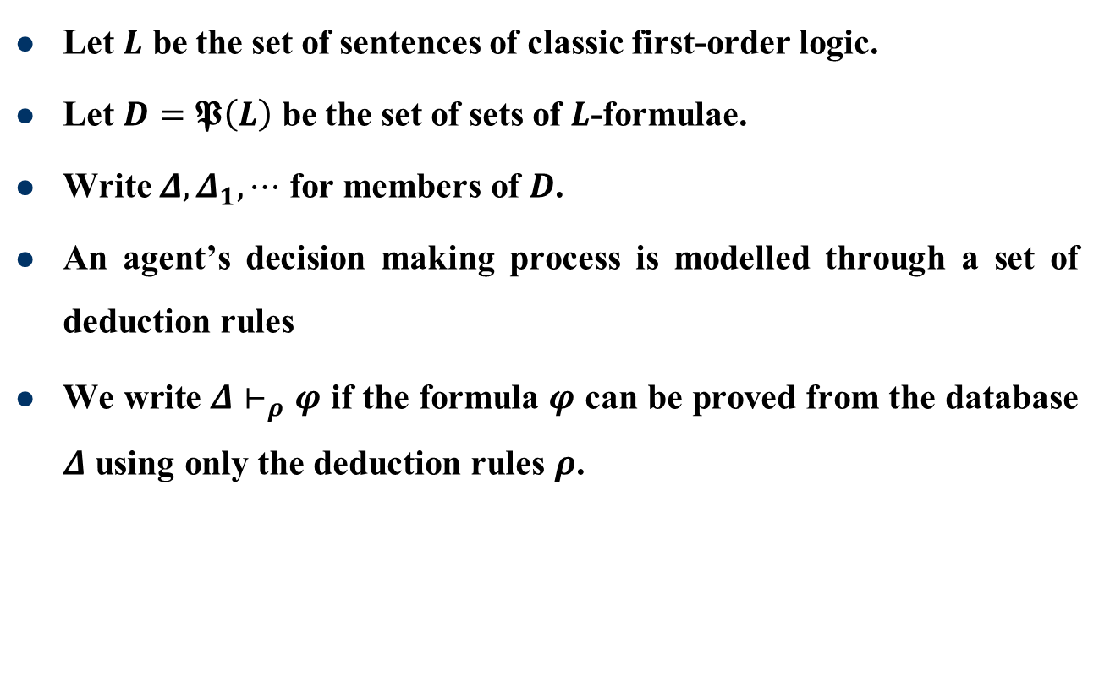


Logic-based architectures: some notions
Let $L$ be the set of sentences of classic first-order logic.
Let $D=𝕻\left(L\right)$ be the set of sets of $L$-formulae.
Write $Δ,Δ_{1},⋯$ for members of $D$.
An agent’s decision making process is modelled through a set of deduction rules
We write $Δ⊢_{ρ}φ$ if the formula $φ$ can be proved from the database $Δ$ using only the deduction rules $ρ$.
$$see:S→P$$
$$next:I×P→I$$
$$action:I→A$$

Slide 17
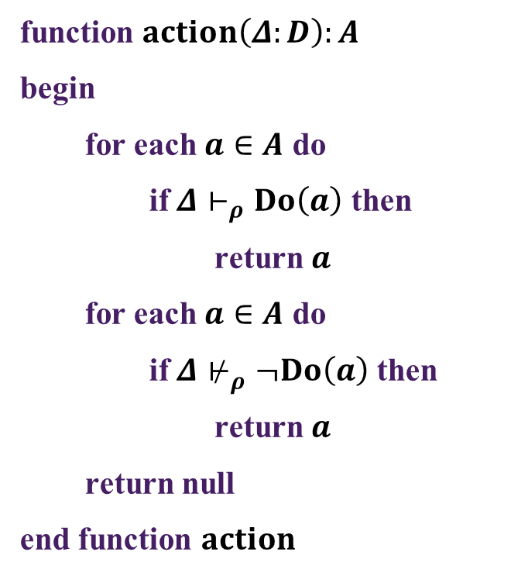
Logic-based architecture: pseudo-code
function $action\left(Δ:D\right):A$
begin
for each $a∈A$ do
if $Δ⊢_{ρ}Do\left(a\right)$ then
return $a$
for each $a∈A$ do
if $Δ⊬_{ρ}¬Do\left(a\right)$ then
return $a$
return null
end function $action$

Slide 18
Example: vacuum world

Slide 19
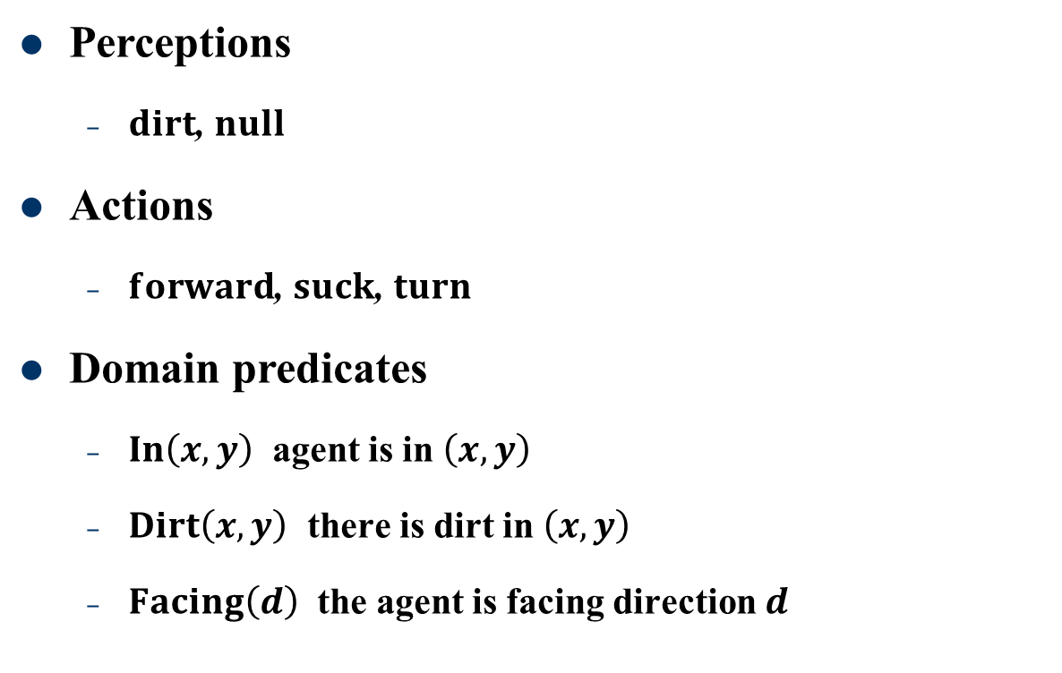
Vacuum world: perceptions and actions
Perceptions
$dirt$, $null$
Actions
$forward$, $suck$, $turn$
Domain predicates
$In\left(x,y\right)$ agent is in $\left(x,y\right)$
$Dirt\left(x,y\right)$ there is dirt in $\left(x,y\right)$
$Facing\left(d\right)$ the agent is facing direction $d$

Slide 20
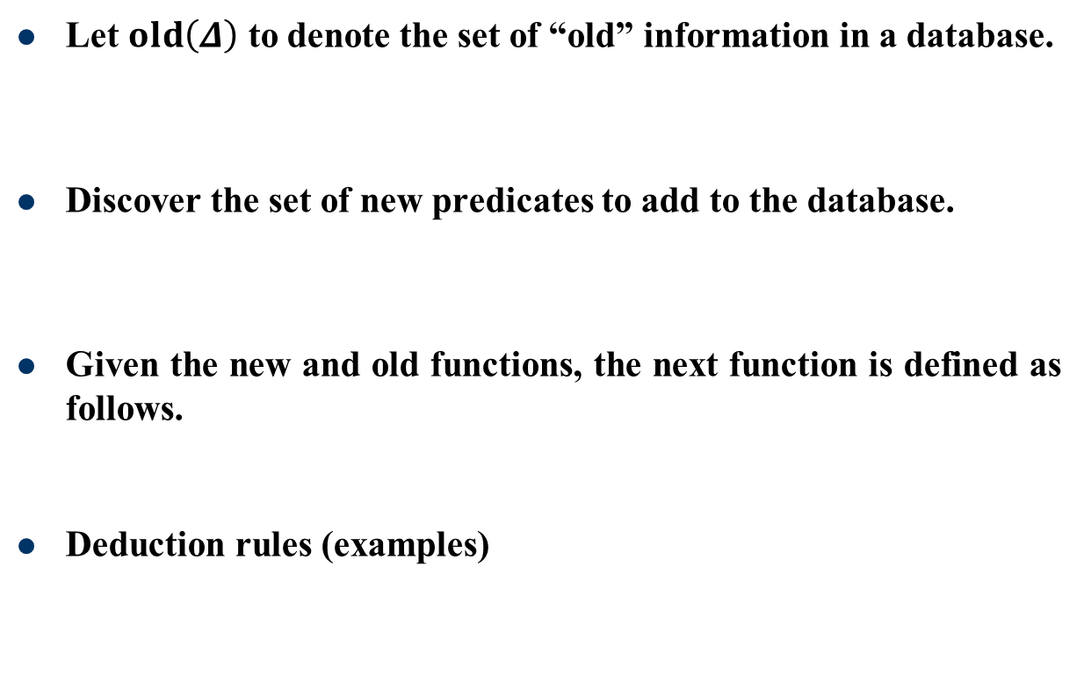



Vacuum world: $next$ function and deduction
Let $old\left(Δ\right)$ to denote the set of “old” information in a database.
Discover the set of new predicates to add to the database.
Given the new and old functions, the next function is defined as follows.
Deduction rules (examples)
$$old\left(Δ\right)=\left\{P\left(t_{1},t_{2},⋯,t_{n}\right)∈Δ | P∈\left\{In,Dirt,Facing\right\}\right\}$$
$$new:D×P→D$$
Not difficult to implement, but rather lengthy.
$$next\left(Δ,p\right)=\left(Δ−old\left(Δ\right)\right)∪new\left(Δ,p\right)$$
$$In\left(x,y\right)∩Dirt\left(x,y\right)→Do\left(suck\right)$$
$$In\left(x,y\right)∩Facing\left(north\right)∩¬Dirt\left(x,y\right)→Do\left(forward\right)$$

Slide 21
Comments on logic-based approaches
Logical approach brings simple and elegant semantics – the agent’s behavior can be guaranteed. This may be useful for safety-critical applications.
But theorem proving takes time – during the time the agent proves which action is optimal the environment may have changed.
This leads to the problem of calculative rationality – the decision making apparatus produces action that was optimal when decision making process began.
Only suitable when the environment doesn’t change faster than the agent can make decisions.
… implying simple representation of the environments and short deduction process

Slide 22
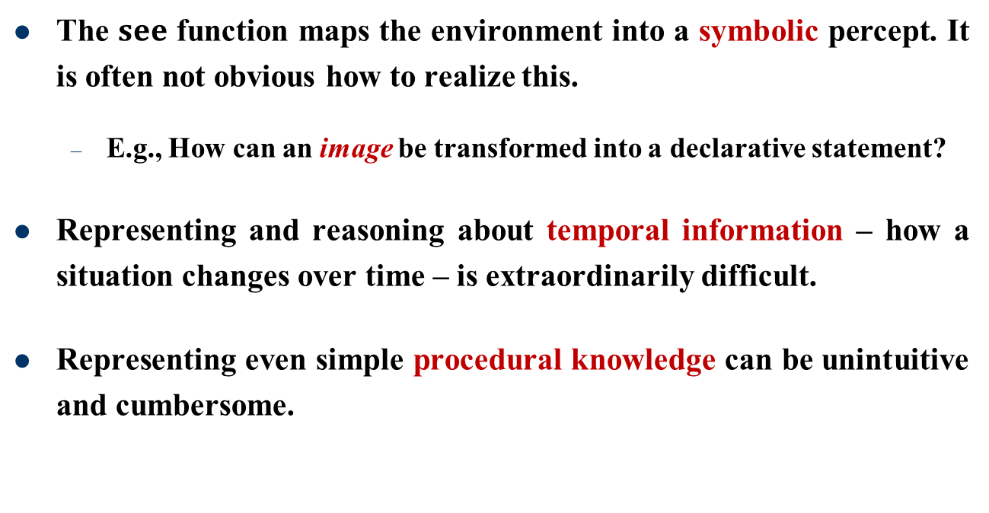
Comments on logic-based approach
The $see$ function maps the environment into a symbolic percept. It is often not obvious how to realize this.
E.g., How can an image be transformed into a declarative statement?
Representing and reasoning about temporal information – how a situation changes over time – is extraordinarily difficult.
Representing even simple procedural knowledge can be unintuitive and cumbersome.

Slide 23
Reactive architectures
Motivations for reactive agents
Rejects decision-making based on syntactic manipulation of symbolic representations of knowledge.
Believes the rational behavior cannot be disembodied but is a product of the interaction the agent maintains with its environment.
Believes that intelligent behavior emerges from the interaction of various simpler behaviors.

Slide 24
Reactive architectures
Sometimes called:
Behavioral: developing and combining individual behaviors.
Situated: agent is situated in its environment – not disembodied.
Reactive: reacts to changes in the environment without explicitly reasoning about it.
Let’s look at the subsumption architecture of Rodney Brooks.
Notes:
包孕

Slide 25
Reactive architectures
Brooks has put forward three theses:
Intelligent behaviour can be generated without explicit representations of the kind that symbolic AI proposes.
Intelligent behaviour can be generated without explicit abstract reasoning of the kind that symbolic AI proposes.
Intelligence is an emergent property of certain complex systems.
Intelligence without Representation, RA Brooks, 1991
Notes:
包孕

Slide 26
Subsumption architecture
He identifies two key ideas that have informed his research:
Situatedness and embodiment: ‘Real’ intelligence is situated in the world, not in disembodied systems such as theorem provers or expert systems.
Intelligence and emergence: ‘Intelligent’ behaviour arises as a result of an agent’s interaction with its environment. Also, intelligence is ‘in the eye of the beholder’; it is not an innate, isolated property.

Slide 27

Subsumption architecture
An agent’s decision-making is realized through a set of task accomplishing behaviors.
Each behavior is like an individual action function, continually taking perceptual input and mapping it onto an action to perform.
No complex symbolic representations and no symbolic reasoning at all.
Mainly implemented through rules like
$$situation→action$$

Slide 28
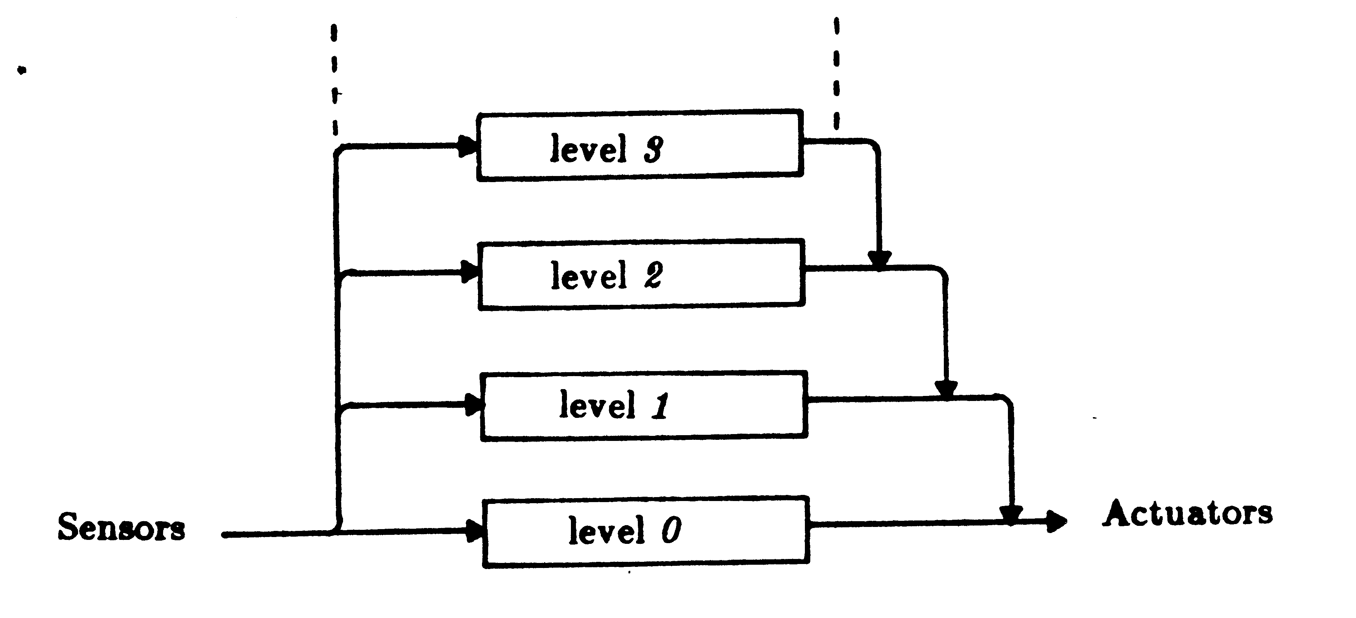
Subsumption architecture
Image from http://cs.brown.edu/~tld/courses/cs148/02/architectures.html, accessed: Dec 13, 2015.

Slide 29
Rule firing
Many behaviors can be fired simultaneously.
The subsumption hierarchy arranges the behaviors in layers that are used to choose between actions.
Lower layers inhibit (have priority over) higher layers.
Higher layer represent more abstract behaviors.
[Example] A mobile robot might have a behavior “avoid obstacles” at a low layer (higher priority) and a behavior “fetch coffee” at a higher layer (lower priority).

Slide 30

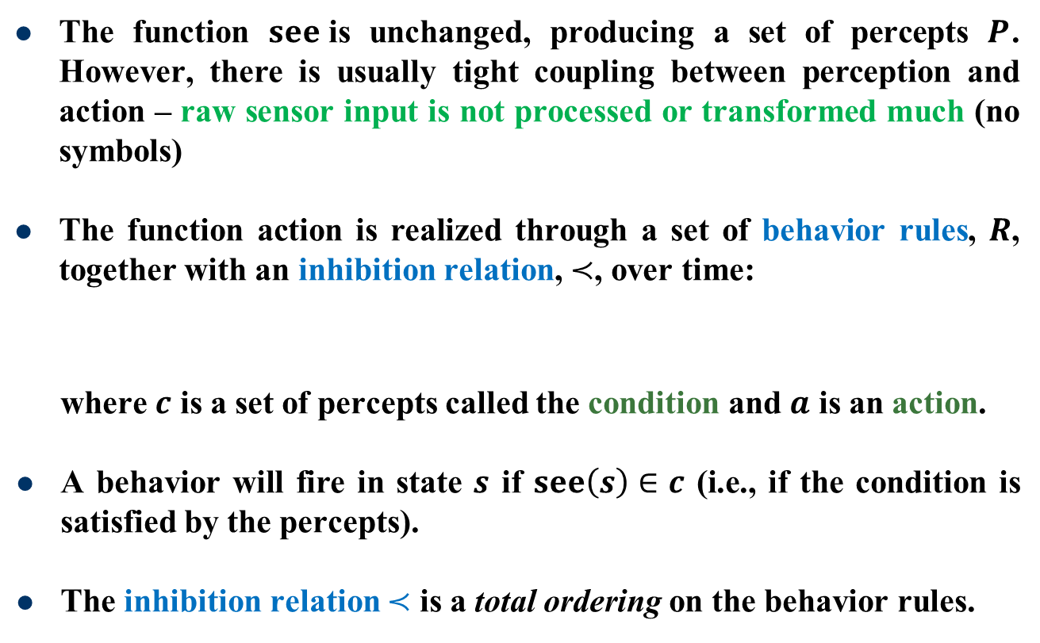
Subsumption sub-systems
The function $see$is unchanged, producing a set of percepts $P$. However, there is usually tight coupling between perception and action – raw sensor input is not processed or transformed much (no symbols)
The function action is realized through a set of behavior rules, $R$, together with an inhibition relation, $≺$, over time:
where $c$ is a set of percepts called the condition and $a$ is an action.
A behavior will fire in state $s$ if $see\left(s\right)∈c$ (i.e., if the condition is satisfied by the percepts).
The inhibition relation $≺$ is a total ordering on the behavior rules.
$R=\left\{\left(c,a\right) | c⊆P,a∈A\right\}$,

Slide 31
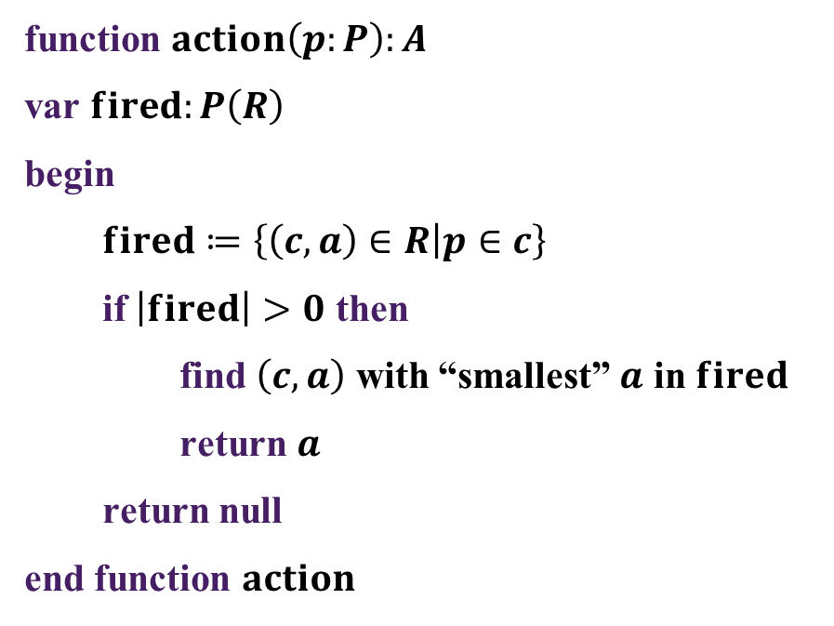
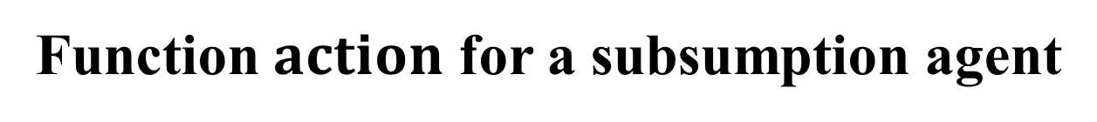
Function $action$ for a subsumption agent
function $action\left(p:P\right):A$
var $fired:P\left(R\right)$
begin
$fired≔\left\{\left(c,a\right)∈R | p∈c\right\}$
if $\left|fired\right|>0$ then
find $\left(c,a\right)$ with “smallest” $a$ in $fired$
return $a$
return null
end function $action$
highest priority
very fast response (nanoseconds) if used with the aid of hardware

Slide 32
Example: exploring a planet
The task is for several robots to explore a distant planet and collect samples of precious rock.
The location of the rock samples is unknown, but typically they are clustered.
Autonomous mobile robots drive around collecting samples and return to the mothership to deposit them.
No map is available, and the terrain is full of obstacles (hills, valleys), which prevent the robots exchanging information.

Slide 33
Robot’s sensors, action, goals
Sensors
Can detect obstacles and rocks
Can detect signal from mothership (variable strengths)
Actions
Can pick up and deposit samples
Can move around terrain
Goals
Avoid obstacles, pick up rocks, and return to the mothership

Slide 34

Robot’s behaviors
B1: if detect an obstacle then change direction
B2: if carrying samples and at base then drop samples
B3: if carrying samples and not at base then travel up signal gradient (i.e., go back to the mothership)
B4: if detect a sample then pick up sample
B5: if true then randomly explore terrain
Inhibition relation
$$B_{1}≺B_{2}≺B_{3}≺B_{4}≺B_{5}$$

Slide 35

Enhancing robot behavior
Even though they cannot communication directly, by interacting with the environment, the mobile robots can communicate indirectly.
Adjust behavior B3:
B3’: if carrying samples and not at base then drop 2 crumbs and travel up signal gradient.
Add behavior B6:
B6: if sense crumbs then pick up 1 crumb and travel down signal gradient.
$$B_{1}≺B_{2}≺B_{3}^{′}≺B_{4}≺B_{5}≺B_{6}$$

Slide 36
Revised reactive behavior
With the simple adjustment, near-optimal performance can be achieved:
Some robots drop a trail of crumbs that leads to the cluster of rocks;
Other robots follow this to find more rock and reinforce the trail on the way back;
When all rocks removed, the trail diminishes since it is no longer being reinforced.
This cooperative behavior emerges from simple reactive rules.
This is similar to ant-like behavior using pheromones.

Slide 37
Reactive architectures: pros and cons
Advantages
Simple, economic, computationally tractable, robust against failure, elegant
Disadvantages
Only react to local information
Short-term view of decision-making
Not capable of learning the environment
Difficult to fully understand emergent properties – engineering specific emergent behavior involves experimentation, trial and error.

Slide 38
Decision-theoretic architecture
Agents use decision theory to determine the best action to take.
Decision theory = Probability Theory + Utility Theory
Decision-theoretic architecture is basically a state-based agent in which decision-theory is used in the action function.
Internal state of agent consists of current beliefs plus:
A probabilistic model of their environment
A utility (or reward) function
The agent selects the action that maximizes its expected utility, given its belief.

Slide 39
Decision-theoretic agent: pros and cons
Disadvantages
Requires complete probabilistic model of environment and reward
Markov decision processes (MDPs) are a powerful way of modeling decision problems but computing solutions (i.e. finding optimal policy) are computationally complex
Advantages
Can incorporate learning techniques (e.g., reinforcement learning)

Slide 40
Belief-desire-intention architecture
The belief-desire-intention (BDI) architectures are examples of practical reasoning – the process of deciding, moment by moment, which action to perform in the furtherance of the goals.
BDI agents use two important processes:
Deliberations: deciding what goals to achieve.
Means-ends reasoning: deciding how to achieve the goals.
Agents not only strive to achieve their goals but must take time to consider whether their goals are still valid and possibly revise them.
The BDI architecture is an example of balancing reactive behavior with goal-directed behaviors.

Slide 41
Beliefs, desires & intentions
To differentiate between these three concepts, consider:
I believe that if I study hard I will pass this course.
I desire to pass this course.
I intend to study hard.
Beliefs and desires shape the intentions that agents adopt.
Intentions drive means-ends reasoning:
Having formed an intention, I will attempt to achieve it
This involved deciding how to achieve it
If one action fails, I will try another
Intentions constrain future deliberation:
I will not act inconsistently with my intentions

Slide 42
Role of intention in practical reasoning
Intentions persist:
I will not give up my intentions without good reason
Typically, they persist until either I believe they have been achieved or I believe they will never be achieved, or if the reason I had the intention is no longer present
Intentions influence beliefs on which future practical reasoning is based
If I adopt an intention, I will plan for the future on the assumption that I will achieve that intention

Slide 43
Balancing reactivity and deliberation
How often should an agent reconsider its intentions?
Bold agents: rarely stops to reconsider; will attempt to achieve intentions even after they are no longer possible or it has no reason for achieving them.
Cautious agents: constantly reconsiders; will spend insufficient time actually working to achieve its intentions, and hence may never achieve them.
The main factor that affects how the agents perform in different environments is how fast the world changes.

Slide 44
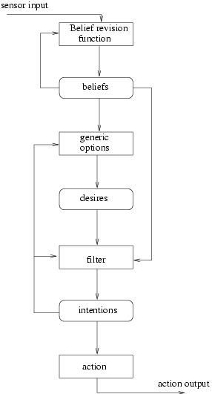
BDI architecture
A BDI agent has 7 main components:
A belief revision function
A set of current beliefs
An option generation function
A set of current desires (options)
A filter function
A set of current intentions
An action selection function

Slide 45
Components of a BDI agent
The beliefs are information about the current environment;
The belief revision function takes perceptual inputs and agent’s current beliefs and, using these, determines a new set of beliefs;
The option generation function determines options available to the agent, using current beliefs and intentions;
The set of current desires (options) represent possible courses of actions available to the agent;
The filter function represents the agent’s deliberation process and determines agent’s intentions on the basis of current beliefs, desires and intentions;
The set of current intentions represent the agent’s current focus – those states of affairs that it has committed to trying to bring about;
The action selection function determines an action to perform on the basis of current intentions.

Slide 46

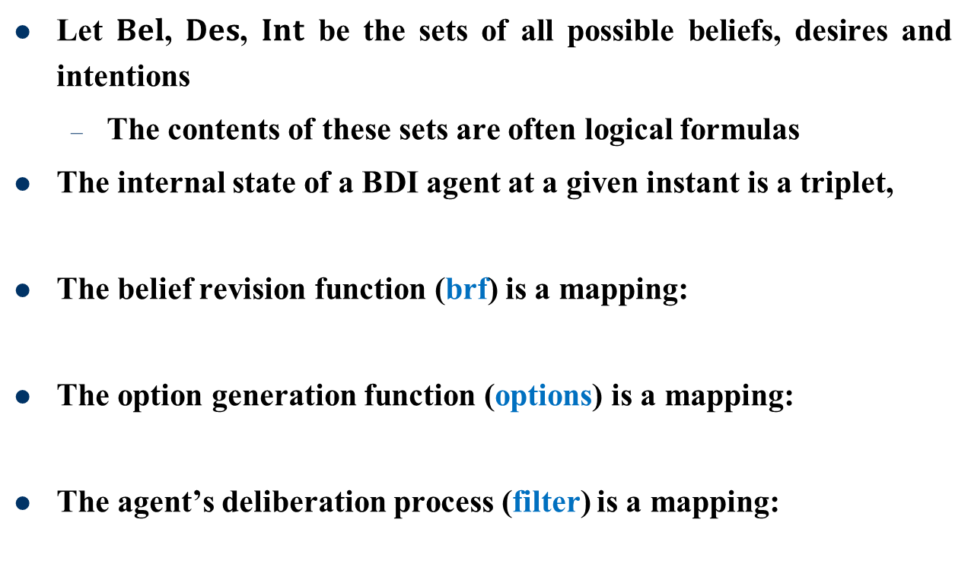



Formalising the BDI agent
Let $Bel$, $Des$, $Int$ be the sets of all possible beliefs, desires and intentions
The contents of these sets are often logical formulas
The internal state of a BDI agent at a given instant is a triplet,
The belief revision function (brf) is a mapping:
The option generation function (options) is a mapping:
The agent’s deliberation process (filter) is a mapping:
$$\left(B, D, I\right)∈Bel×Des×Int$$
$$brf:Bel×P→Bel$$
$$options:Bel×Int→Des$$
$$filter:Bel×Des×Int→Int$$

Slide 47
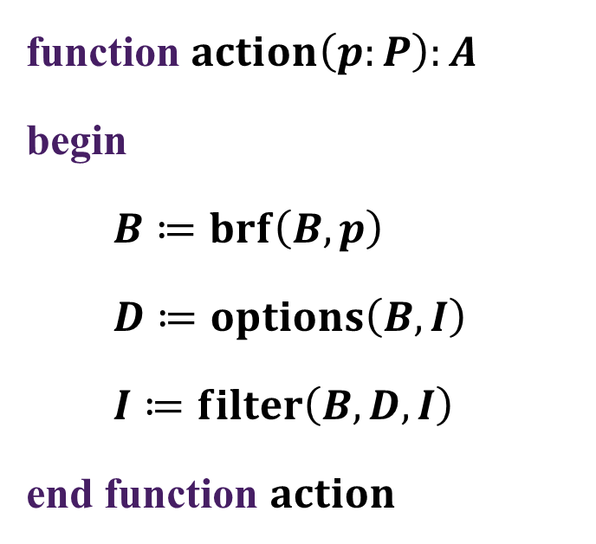

Function $action$ for a BDI agent
function $action\left(p:P\right):A$
begin
$B≔brf\left(B,p\right)$
$D≔options\left(B,I\right)$
$I≔filter\left(B,D,I\right)$
end function $action$

Slide 48
Representation of intentions
Note that representing intentions as a set is generally too simple. Usually, each intention has a priority indicating its relative importance.
Alternatively, intentions might be stored on a stack – pushed on when adopted and popped off when either achieved or dropped; more abstract intentions will tend to be at the bottom of the stack and more concrete (executable) intentions at the top.

Slide 49
Summary of BDI architecture
It is a practical reasoning architecture.
Basic component are data structures representing beliefs, desires and intentions of agent, and functions representing its deliberation and means-ends reasoning.
Intentions play a central role: proving stability for decision-making and focus for practical reasoning (or planning).

Slide 50
Summary of BDI architecture
Must consider the type of environment (rate of world change) to enable a good balance between being committed to intentions and reconsidering them.
BDI model is appealing because:
It is intuitive – we can recognize the decision process
It gives a clear functional decomposition, indicating what sorts of subsystems are required to build an agent
Main drawback – how to implement it efficiently?

Slide 51


Example: Passing this course
A student agent perceives the following beliefs:
The agent has an initial intention to pass the course:
Assume that the agent’s desires are freshly generated each cycle (i.e., they do not persist). The option generation function leads to desires to pass the course and its consequence:
$${Bel}_{1}=brf\left(∅,\left\{\begin{matrix}workHard→passCourse, \\ attendLectures∩doProjects∩review→workHard\end{matrix}\right\}\right)$$
$$=\left\{\begin{matrix}workHard→passCourse, \\ attendLectures∩doProjects∩review→workHard\end{matrix}\right\}$$
$${Int}_{0}=\left\{passCourse\right\}$$
$${Des}_{1}=options\left({Bel}_{1},{Int}_{0}\right)$$
$$=\left\{workHard,attendLectures,doProjects,review\right\}$$

Slide 52

Generating intentions
The filter function leads to some new intentions being added:
One or more of which will then be executed before the agent’s deliberation cycle recommences.
$${Int}_{1}=filter\left({Bel}_{1},{Des}_{1},{Int}_{0}\right)$$
$$=\left\{passCourse,workHard,attendLectures,doProjects,review\right\}$$

Slide 53
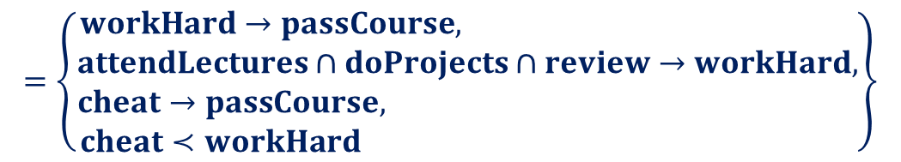

Obtaining new beliefs
Suppose the agent perceives new information which leads to his beliefs being revised:
$${Bel}_{2}=brf\left({Bel}_{1},\left\{\begin{matrix}cheat→passCourse, \\ cheat≺workHard\end{matrix}\right\}\right)$$
$$=\left\{\begin{matrix}workHard→passCourse, \\ \begin{aligned}attendLectures∩doProjects∩review→workHard, \\ cheat→passCourse, \\ cheat≺workHard \end{aligned}\end{matrix}\right\}$$

Slide 54
Revising desires and intentions
The agent recomputes his desires
And intentions
The agent drops his original intention to work hard (and its consequences) and adopts a new one to cheat
$${Des}_{2}=options\left({Bel}_{2},{Int}_{1}\right)=\left\{cheat\right\}$$
$${Int}_{2}=filter\left({Bel}_{2},{Des}_{2},{Int}_{1}\right)=\left\{passCourse, cheat\right\}$$

Slide 55


Adding more beliefs…
Subsequently, the agent perceives that if caught cheating, he will no longer pass the course. Moreover, he will certainly be caught.
Because the new beliefs lead to an inconsistency, the agent has to drop his belief in $cheat→passCourse$.
$${Bel}_{3}=brf\left({Bel}_{2},\left\{\begin{matrix}cheat∩caught→¬passCourse, \\ caught\end{matrix}\right\}\right)$$
$$={Bel}_{2}−\left\{cheat→passCourse\right\}∪\left\{\begin{matrix}cheat∩caught→¬passCourse, \\ caught\end{matrix}\right\}$$

Slide 56

Revising desires and intentions, again
The agent recomputes his desires and intentions
Because it’s no longer consistent to cheat (even through it may be preferable to working hard), the agent drops that intention and re-adopts working hard (and its consequences).
$${Des}_{3}=options\left({Bel}_{3},{Int}_{2}\right)$$
$$=\left\{workHard,attendLectures,doProjects,review\right\}$$
$${Int}_{3}=filter\left({Bel}_{3},{Des}_{3},{Int}_{2}\right)$$
$$=\left\{workHard,attendLectures,doProjects,review\right\}$$

Slide 57
Layered architectures
Aim is to decompose agent into separate subsystems that deal with different types of behavior.
Arranged in a hierarchy of interacting layers.
At least two layers – reactive and proactive – often many other layers.
Characterized by the information and control flows within them.

Slide 58
Types of layering
In general two types of layered agent architecture
Horizontal layering
The software layers are each directly connected to sensory input and action output.
Each layer acts like agent, producing suggestions of which action to perform.
Vertical layering
Sensory input and actions output dealt with by one only each.

Slide 59

Horizontally layered architectures
Conceptually simple – an agent with $n$ different types of behaviors can be implemented in $n$ different layers.
Layers compete with one another to generate action suggestions
must ensure that the overall behavior of agent is coherent
generalizes subsumption architecture

Slide 60
Horizontally layered architectures
Generally include a mediator that determines which layer has control of agent at any given time – can cause problems as all possible interactions need to be considered at design time.
Centralised control may also lead to a bottleneck in the agent’s decision-making.

Slide 61
Vertically layered architectures
Two types
One-pass control
Control flows sequentially through each layer; the final layer generates the output.
Two-pass control
Information flows up the architecture (first pass) and control then flows back down (second pass).

Slide 62
TouringMachine

Slide 63
InteRRap

Slide 64
Layered architectures: pros and cons
Pros: in both versions of vertically layered architecture, the complexity of interactions between the layers is reduced.
Cons: control must pass through each different layer – not very robust if a layer fails

Slide 65
Summary
Abstract architectures for intelligent agents
Concrete architectures for intelligent agents
Logic-based architectures
Reactive architectures
Decision-theoretic architectures
Belief-desire-intention architectures
Layered architectures

